Slide 1

Speak Fluently & Confidently A2 to B1- - Course 1

Slide 2
Session 2- Talking about Family
Part 1-: My English Family ( Listening)
Part 2: What would you say in the following
situations? ( More Idioms & collocations)
Part 3: Speaking Practice
https://befluent.me/

Slide 3
Session 2- Talking about Family
Part 1-: My English Family
( Listening )
https://befluent.me/

Slide 4
Script:
Todd: So, Katie, let's talk about family.
Katie: Okay.
Todd: In your family, who is nice?
Katie: In my family, I think my, my mum is really nice. She's always looking out for everyone. She always makes sure everybody is happy. And she's just really nice and kind.
Todd: Wow! That's great. Who is a funny person? Who is very funny?
Katie: I think in my family; my dad is very funny. But I don't think he knows he's very funny.
Todd: Alright. Oh, that's interesting. Now who is serious? Is anybody serious?
Katie: I don't think anybody is serious in my family.
Todd: No uncles or aunts?
Katie: Everyone likes to have a laugh. Everyone likes to have a good time.
Todd: Oh that-

Slide 5
Script:
Katie: Everyone is always joking.
Todd: Oh, what I nice family.
Katie: (laughs)
Todd: OK. Who is very hardworking?
Katie: Ooohh. Well obviously, my mum is very hardworking. And she's always been very hardworking. She has to make sure that the whole family knows what they're doing. She has to make sure the whole family is ready for every day. Yeah, I think my mum is the hardworking one.
Todd: OK. Is anybody not hardworking? Maybe a little lazy?
Katie: Definitely me. (laughs) Definitely me especially when I was younger. I would never help with any of the chores in the house. I was definitely the lazy one.
Todd: Oh, I understand, I'm the same way. OK. Now in your family, who is very smart?
Katie: My brother is really, really smart. He actually went to Oxford University.
Todd: Whoa.

Slide 6
Script:
Katie: Yeah, he's very smart. But I didn't get any of that. My brother has all the smart genes.
Todd: Wow, that's a good school. OK. Who is very fit?
Katie: Hmm... Well, my dad is a chef and-
Todd: Oh, really?
Katie: Yeah. My dad makes really, really good food, so no one in my family is fit. We all eat too much food.
Todd: Oh, nobody exercises a lot?
Katie: Not really.
Todd: Oh, okay. Yeah, in my family, my dad is super fit.
Katie: (laugh)
Todd: OK. In your family, who is talkative?
Katie: Oh, I keep saying my mum for all of these but my mum is definitely the most talkative. She talks to anybody who - even people who she doesn't know. She will talk to anybody, strangers on the street, people she meets at the bus stop. She talks to everybody.

Slide 7
Script:
Todd: Oh, that's cool. Now, who is quiet?
Katie: Hmm, I think when he's meeting people for the first time, my brother is very quiet. He's very shy. He doesn't like speaking to new people a lot.
Todd: OK. Thanks a lot. Sounds like a nice family.
Katie: Yeah. I think so too.

Slide 9
Diabetes is passed down from your family.
Inherit

Slide 10
Vocabulary Quiz
l
looking out for • obviously • chores genes • fit • strangers
He runs every day. He is very .
My dad is always out for me.
He is not happy. He looks mad.
You can meet when you travel.
He has the smart in the family.
I did not finish all my .

Slide 13
Session 2- Talking about Family
Part 2: What would you say in the following
situations? ( More Idioms & collocations)
https://befluent.me/

Slide 14
Session 2- Talking about Family
Like Father, Like Son
Meaning: Sons inherit their fathers’ traits and preferences, often even without realizing it.
Example: John was a great fisherman, and his son Matt a great fisherman too. Like father, like son.
Cooker بوتجار – - cook طباخ – mona was a great cook and her daughter, …. is a great cook. Like father , like son.
Run in the Family
Meaning: Be inherited (as a trait) by multiple members of a family
Example: I’m not surprised Maria has started playing in a band فرقة موسيقية.
Musical talent runs in her family.
One Big Happy Family
Meaning: A group of people who live or work together or in close proximity
we’re at work seem to be one big happy family.
I enjoy working at Be fluent. We are one big happy family.
Family Man
Meaning: A man devoted to taking care of his wife and children.
My dad is a family man.
A Helicopter Parent
overprotects (verb) –overprotective ( adj)
Meaning: a parent who overprotects and overcontrols their children, hovering around like a helicopter and monitoring everything that the children do.
Example: His mum was a real helicopter parent and sent instructions to the kitchen on how to cook her son’s rice for every meal.
https://befluent.me/

Slide 15
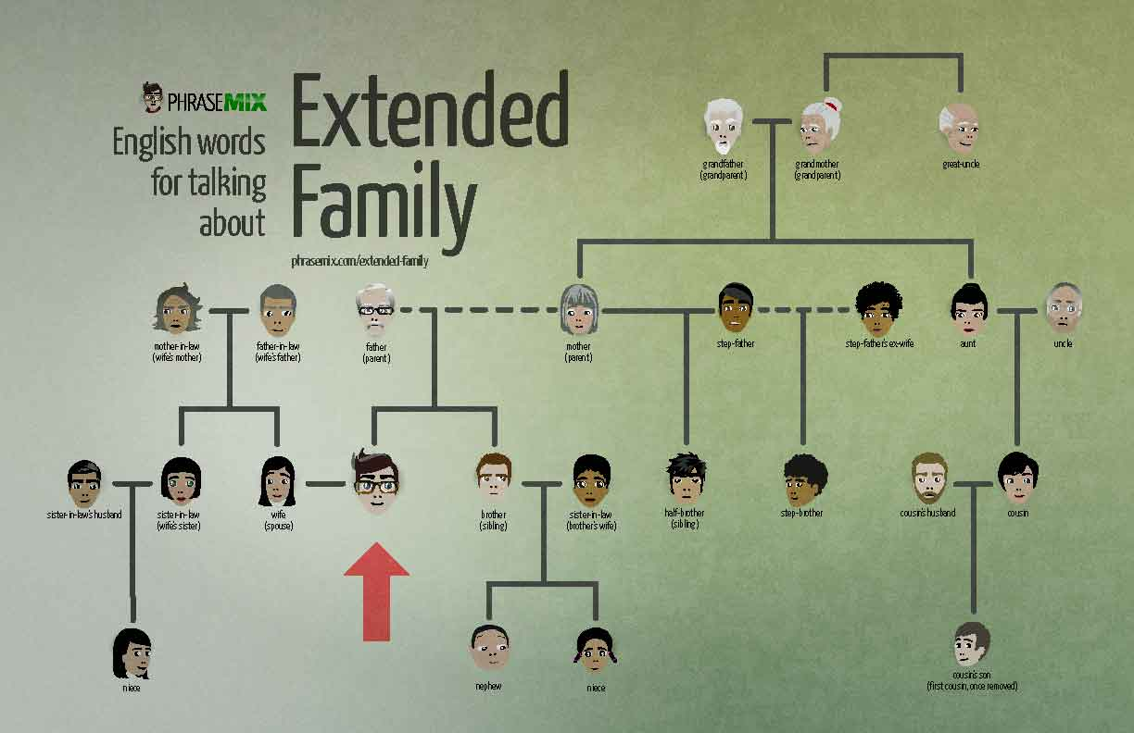
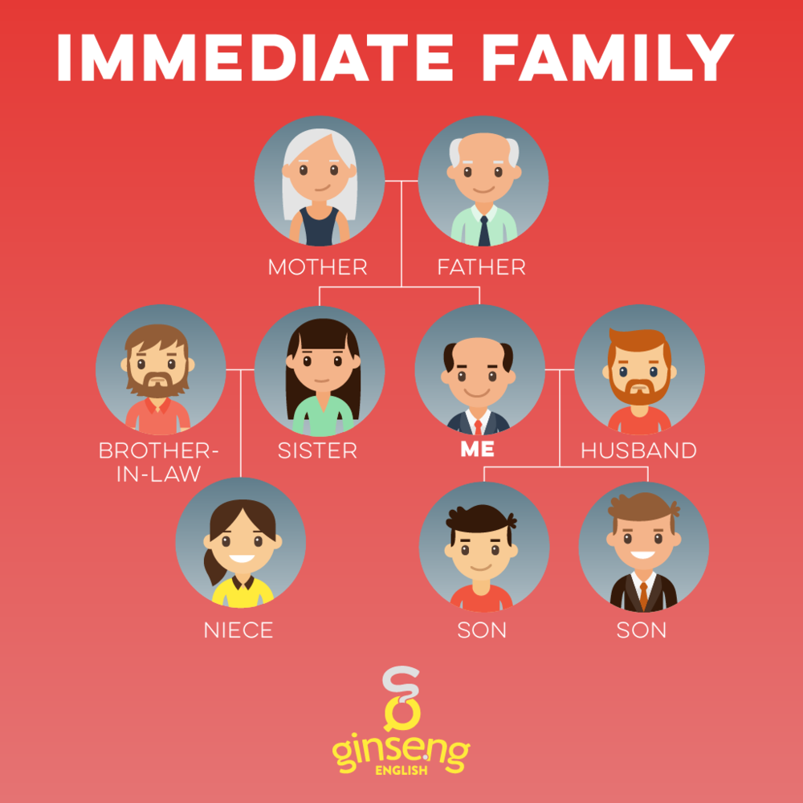
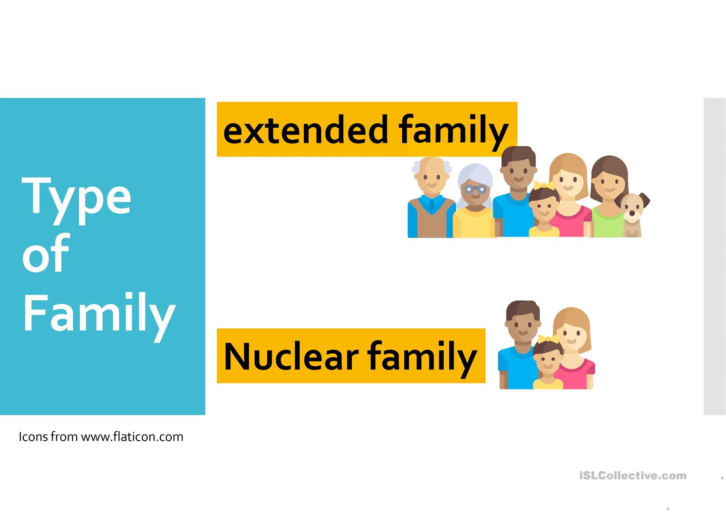
Session 2- Talking about Family
My nuclear family is made up of my father, my mother …
I am one of four siblings.
= Nuclear Family
= Immediate Family
https://befluent.me/

Slide 16
Session 2- Talking about Family
Part 3: Speaking Practice
https://befluent.me/

Slide 17
Session 2- Talking about Family
(Like Father, Like Son -Run in the Family- One Big Happy Family -Family Man- A Helicopter Parent)
Answer the following questions using some of the above idioms:
Tell me about your family.
Student : My sister is very kind . I think kind genes run in the family.
Correction: My sister is very kind . I think kindness genes run in the family. Kind : adjective طيبة – kindness : noun الطيبة
Do you have a big family? / Would you like to have a big or a small family?
Student : I have a small family .in the past I would like to have a big family. But after I had my children I said that’s this enough. When I with my children we seem to be one big happy family.
Correction: No, I have aplay small family. In the past I wanted to have a big family. But after I had my children, I thought that this is enough. When I play with my children we seem to be one big happy family.
Are friends more important than family? What do you think?
Student : no, for me my friends aren’t more important than family. This is nature that family is the the most important.
Correction: : no, for me, my friends aren’t more important than my family. This is normal that family is the most important thing ./ is more important than others. Nature: الطبيعة normal: العادي ( الطبيعي) natural: طبيعي
What do you think of assigning chores to children in the family?
Student : I absolutely love this/ that. I really distribute tasks on my children.
Correction: I absolutely love this. In fact, I share the chores with my family. / As a family, we share the chores. We are one big happy family. Like father –like son.
https://befluent.me/

Slide 18
Session 2- Talking about Family
(Like Father, Like Son -Run in the Family- One Big Happy Family -Family Man- A Helicopter Parent)
Answer the following questions using some of the above idioms:
What do you like doing when you spend time with your family?
Student : I absolutely love going shopping with my family. Go out = hang out Get out = اطلع برة
Walking in the street
Correction: I absolutely love to go walking with my family. I absolutely love going on long walks with my family.
Did you ever meet any of your great grandparents?
Student :
Correction:
How did you get your name? Who are you named after?
Student : my dad named me . I was named after a princess in the gulf.
Correction: It was my dad who called/ named me . I was named after a princess in the Gulf.
What is the most important thing your parents taught you? Taught= يعلم past of teach
Student : my parents taught me to love my siblings and take care of them/ to look out for them.
Correction: ☺
https://befluent.me/

Slide 19
Session 2- Talking about Family
(Like Father, Like Son -Run in the Family- One Big Happy Family -Family Man- A Helicopter Parent)
Answer the following questions using some of the above idioms:
If you could have a different number of siblings and children, what would it be? Why?
Student :
Correction:
If you were offered an excellent job opportunity abroad, would you consider leaving your family for an indefinite period of time?
Student :
Correction:
https://befluent.me/

Slide 20
Session 2- Talking about Family
(Like Father, Like Son -Run in the Family- One Big Happy Family -Family Man- A Helicopter Parent)
There is much talk recently of increased social problems due to family breakdown. Is this true?
Student :
Correction:
Do you ever get tired of family duties?
Student :
Correction:
Do you consider close friends as family? Explain why?
Student :
Correction:
https://befluent.me/

Slide 21

Session 2- Talking about Family
(Like Father, Like Son -Run in the Family- One Big Happy Family -Family Man- A Helicopter Parent)
Do you like taking photos with your family?
Student : yes, I like taking photos with my family. We are one big happy family.
Correction:
Can you describe this picture?
Student : I see big family contains grandpa, grandma, father and daughter and they are one big happy family. they are talking happily.. They are spending a good time together.
Correction: I see a big family made up of a grandpa, a grandma, a father and a daughter and they are one big happy family. They are enjoying talking together/ they are enjoying their time together. They are having a good time together.
(v. to be )+ made up of : مكون من
https://befluent.me/

Slide 22
Session 2- Talking about Family
Thank you!☺
https://befluent.me/

